Slide 1
Highway Materials Lecture - 13
Designed and presented
By
Asst. Prof. Dr. Raquim Nihad Zehawi

Slide 2
ASPHALT MIXTURES
Asphalt mixtures are a uniformly mixed combination of asphalt cement, coarse aggregate, fine aggregate, and other materials, depending on the type of asphalt mixture.
Asphalt mixtures are the most popular paving material
When Asphalt mixtures used in constructing highway pavements, it must:
- resist deformation from imposed traffic loads,
- be skid resistant even when wet, and
- not be affected easily by weathering forces
Note:
• Batch plant: percentage depend on weight. Continuous plant: percentage depend on volume.
• Hot mix: after heating aggregate & asphalt. Cold mix: mixing at normal temperature (emulsified asphalt).
• Dense mix: % air voids ≤ 10%. Open mix: % air voids > 10%.

Slide 3
Hot-Mix, Hot-Laid Asphalt Mixture
Hot-mix, hot-laid asphalt mixture is produced by properly blending asphalt cement, coarse aggregate, fine aggregate, and filler (dust) at temperatures ranging from about 175 to 325F, depending on the type of asphalt cement used.
Suitable types of asphalt materials include AC-20, AC-10, and AR-8000 with penetration grades of 60 to 70, 85 to 100, 120 to 150, and 200 to 300.
hot-laid asphalt mixture normally is used for high-type pavement construction, and the mixture can be described as
High-Type Surfacing
Base
open-graded
M.S. 3⁄8 to 3⁄4 in
M.S. 3⁄4 to 11⁄2 in
coarse-graded
M.S. 1⁄2 to 3⁄4 in
M.S. 3⁄4 to 11⁄2 in
dense-graded
M.S. 1⁄2 to 1 in
M.S. 1 to 11⁄2 in
fine-graded
M.S. 1⁄2 to 3⁄4 in
M.S. 3⁄4 in
The overall objective of the mix design is to determine an optimum blend of the different components that will satisfy the requirements of the given specifications.

Slide 4
Main desirable properties of aggregate:
1) Inter particle friction
The primary mechanism of load transfer:
a. Surface texture:
particles rough surface provides the resistance to displacement
b. Particle shape:
the more angular the particles the more the interlock between them, many shapes for particles, round, fractured, & cubical
Angularity No. = voids percentage in round particles - voids percentage in any shape
0% < Angularity No. > 10%
c. Gradation
Aggregate is either dense graded or open graded, it is not recommended to have any gabs in its gradations
The ultimate dense gradation can be obtained according to Fuller equation:
$\frac{P}{100}={\left(\frac{d}{D}\right)}^{0.5}$
D = diameter of max. size particle, (passing 100%); inch
d = size of opening for any sieve, inch
P = percent passing of that sieve.

Slide 5
2) Durability:
Durability represents the resistance to crashing, degradation, and disintegration.
a. Crashing
Aggregates used in pavement construction should be strong enough to resist crushing under traffic wheel loads
It is usually indicated by the Crashing Value
Aggregates passing 12.5 mm sieve and retained on 10 mm subjected to a pressure of 40 tons
$$Crushing Value=\frac{Weight of materials passing sieve No.7}{Original Weight}$$
Crashing Value should be $≤12\%$

Slide 6
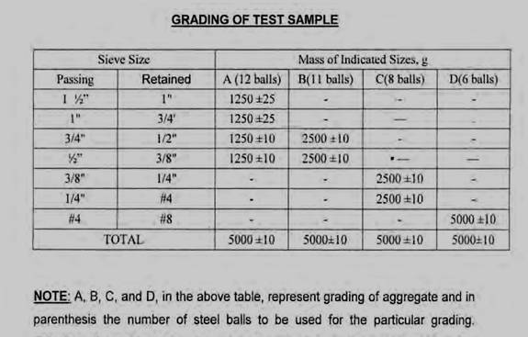
b. Degradation
damaging or ruining caused mainly due to mechanical effect
The Los Angeles test is a measure of degradation of mineral aggregates of standard grading resulting from abrasion or attrition, impact, and grinding in a rotating steel drum containing steel spheres.
The (L.A.) abrasion test is used to indicate aggregate toughness and abrasion characteristics
Aggregate abrasion characteristics are important because aggregate in HMA must resist crushing, degradation and disintegration in order to produce a high quality HMA.
$Abrasion Value=\frac{weight of materials passing sieve No.12}{Original sample weight}$
Should be $≤30\%$

Slide 7
c. Disintegration
Fragmentation in mineral aggregate due to chemical effect
Chemical Stability: refers to specific problems due to chemical composition
The soundness test determines an aggregate’s resistance to disintegration by weathering and, in particular, freeze-thaw cycles.
The soundness test repeatedly submerges an aggregate sample in a sodium sulfate or magnesium sulfate solution. This process causes salt crystals to form in the aggregate’s water permeable pores.
The formation of these crystals creates internal forces that apply pressure on aggregate pores and tend to break the aggregate.
After a specified number of submerging and drying repetitions, the aggregate is sieved to determine the percent loss of material.

Slide 8
3) Wet ability:
Means the aggregate adhesion with asphalt, or resistance to stripping of asphalt film from aggregate in the presence of water
It is affected by:
a. Mechanical interlock:
Developed by:
- Rough surface texture.
- Porous aggregate
- No surface coating

Slide 9
b. Chemical reactivity:
_{Basic minerals}
_{(of aggregate)}
+
_{Acidic portion}
_{(of asphalt)}
=
_{Compound not soluble in water}
c. Interfacial tension:
- Hydrophobic aggregate (water-hating) preferable
- Hydrophilic aggregate (water-loving) non-preferable (local)

Slide 10
Aggregate Gradation
The first phase in any mix design is the selection and combination of aggregates to obtain a gradation within the limits prescribed. This sometimes is referred to as mechanical stabilization.
Aggregates usually are categorized as course, fine, and filler. The coarse aggregate retained in a No. 8 sieve, sand is predominantly fine aggregate passing the No. 8 sieve, and filler is predominantly mineral dust that passes the No. 200 sieve
The procedure used to select and combine aggregates is as follows:
1. Discarding the over size.
2. Separating into two or more portions on selected proper sieve.
3. Recombining using proper percentage for recombination with specification requirement (mid-specification limits).
4. Addition of fine materials (& Filler) if necessary.

Slide 11
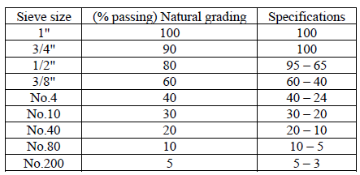
Example 6
Rectify the gradation of the aggregate according to the listed specification.
Solution
First: the oversize in sieve ¾” should be discarded to comply with the spec., by discarding retained materials on 1” and ¾” the remaining sample will be 100% passing both of these sieves but this may lead to another violation in other sieves.

Slide 12
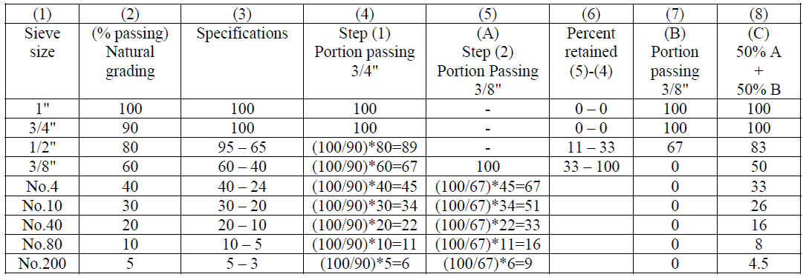
Second: the violation is seen all over the rest of the sieves starting from 3/8” on. Accordingly the rectifying process requires the separation in this sieve and calculating the remaining on the higher sieves then to compute the passing proportions in order to consider each part as different sample on which several trials of blending proportions to be conducted until the specification is reached.
In this case 50% of each part will make the sample compatible with the required specification

Slide 13
Example 7
Rectify the gradation of the aggregate according to the listed specification.
1 | 2 | 3 | 4
Sieve | Specifications | Target | Passing Natural Grading
3/4" | 100 | 100 | 90
1/2" | 90 – 100 | 95 | 82
3/8" | 77 – 93 | 85 | 72
No. 4 | 44 – 74 | 59 | 40
No. 8 | 24 – 58 | 41 | 26
No. 50 | 5 – 21 | 13 | 4
No. 200 | 4 – 10 | 7 | 0.5
Solution
1- Step (1): discarding the oversize. i.e. discarding the retained on 3/4" sieve which equals 10% of the whole original stock pile.
Since the 90% is going to be 100% of the new stockpile after discarding the oversize material, then all other proportions are to be computed as follows:
$$new proportion \%=\frac{100}{90}×old proportion\%$$

